Slide 1
The Association Between Red Meat Intake and Coronary Heart Disease (CHD) in The Nurses’ Health Study
Correcting for Measurement Error in
Baseline and Cumulative Average Assessments with Regression Calibration for Survival Data Analysis
Donna Spiegelman, ScD
Susan Dwight Bliss Professor of Biostatistics
Yale School of Public Health
March 15, 2026
Xiao Gu , Molin Wang, Walter Willett
Harvard School of Public Health
Boston, MA

Slide 2





Red Meat Intake and Coronary Heart Disease
Main takeaway
Higher intake of red meat is associated with modestly higher CHD/CVD risk, with the strongest and most consistent association for processed red meat.
What the evidence shows
What helps most
How strong is the evidence?
Cohort and meta-analytic data suggest modestly higher CHD/CVD risk with higher red-meat intake.
Processed red meat generally shows the strongest adverse association.
Unprocessed red meat shows a smaller but still positive association.
Replacing red meat with nuts, legumes, soy, and whole grains is associated with lower CHD risk.
Replacement appears more important than meat viewed in isolation.
Plant-protein replacement also improves LDL-C in trials.
Strongest for observational diet-disease associations.
Supported by short-term mechanistic and lipid trial data.
Causal certainty remains incomplete.
Practical prevention message
Replace red meat with plant-based protein sources when possible
Evidence base includes Eur Heart J 2023 meta-analysis; BMJ 2020 cohort; Nutr Rev 2022 substitution meta-analysis; Clin Nutr 2025 network meta-analysis; Eur Heart J 2019 TMAO trial; Circulation 2021 AHA guidance.
Notes:
[Sources] - Shi W, et al. Eur Heart J. 2023;44:2626-2635. Meta-analysis on red meat and CVD. - Al-Shaar L, et al. BMJ. 2020;371:m4141. Red meat intake and CHD in US men. - Hidayat K, et al. Nutr Rev. 2022;80:1959-1973. Substitution meta-analysis. - Lopez-Moreno M, et al. Clin Nutr. 2025;54:12-26. Network meta-analysis on animal vs plant proteins and lipids. - Wang Z, et al. Eur Heart J. 2019;40:583-594. TMAO feeding trial. - Lichtenstein AH, et al. Circulation. 2021;144:e472-e487. AHA dietary guidance.

Slide 3
Red Meat Intake and Coronary Heart Disease
Main takeaway
Higher intake of red meat is associated with modestly higher CHD/CVD risk, with the strongest and most consistent association for processed red meat.
How does correcting for measurement error change the interpretation of these data?
What the evidence shows
What helps most
How strong is the evidence?
Cohort and meta-analytic data suggest modestly higher CHD/CVD risk with higher red-meat intake.
Processed red meat generally shows the strongest adverse association.
Unprocessed red meat shows a smaller but still positive association.
Replacing red meat with nuts, legumes, soy, and whole grains is associated with lower CHD risk.
Replacement appears more important than meat viewed in isolation.
Plant-protein replacement also improves LDL-C in trials.
Strongest for observational diet-disease associations.
Supported by short-term mechanistic and lipid trial data.
Causal certainty remains incomplete.
Practical prevention message
Replace red meat with plant-based protein sources when possible
Evidence base includes Eur Heart J 2023 meta-analysis; BMJ 2020 cohort; Nutr Rev 2022 substitution meta-analysis; Clin Nutr 2025 network meta-analysis; Eur Heart J 2019 TMAO trial; Circulation 2021 AHA guidance.
Notes:
[Sources] - Shi W, et al. Eur Heart J. 2023;44:2626-2635. Meta-analysis on red meat and CVD. - Al-Shaar L, et al. BMJ. 2020;371:m4141. Red meat intake and CHD in US men. - Hidayat K, et al. Nutr Rev. 2022;80:1959-1973. Substitution meta-analysis. - Lopez-Moreno M, et al. Clin Nutr. 2025;54:12-26. Network meta-analysis on animal vs plant proteins and lipids. - Wang Z, et al. Eur Heart J. 2019;40:583-594. TMAO feeding trial. - Lichtenstein AH, et al. Circulation. 2021;144:e472-e487. AHA dietary guidance.

Slide 4
Background
The controversial association between red meat intake and CHD could be attributed to unaccounted measurement errors in dietary data.
Here, we compare the risks of CHD associated with red meat intakes assessed only at baseline, with repeated assessments over follow-up, and with each corrected for measurement error.
Main Study
Validation Study
The Nurses’ Health Study (NHS) recruited 121,700 female registered nurses aged 30 to 55 y in 1976 from 11 US states.
Participants have been followed biennially through mailed questionnaires about diseases and health-related topics.
Dietary intakes were assessed every 2 to 4 y using semiquantitative food frequency questionnaires (FFQs).
In this analyses, we start follow-up in 980, the year when the dietary data was first collected.
Participants who reported a baseline history of diabetes, myocardial infarction, angina, stroke, coronary artery bypass grafting, or cancer, and those who had an energy intake of <500 kcal/d or >3500 kcal/d, had missing age or baseline red meat intake were excluded.
The final analytical population included 84,354 women.
Participants of the Women’s Lifestyle Validation Study (WLVS) were recruited as subsets of the NHS and NHS II.
Dietary intakes were assessed by both FFQs and 7-day weighed diet records (7DDRs). FFQs were administered at the baseline and end of the 1-year study period.
Two 7DDRs, as the reference assessments, were collected approximately 6 months apart within the study period.
The current analysis included 741 women from WLVS after excluding participants with unplausible dietary data (e.g., extreme energy intake).

Slide 5


The Measurement Error Model Fit in The Validation Study
Z (error-prone dietary intakes measured by FFQ):
t/p/urmeat_ffq (total/processed/unprocessed red meat, serving/day), calorv_ffq (total energy, kcal/day), aofib_ffq (dietary fiber, gram/day), fruits_ffq (fruits, serving/day), vegeal_ffq (vegetables, serving/day)
X (reference dietary intakes measured by 7DDR):
t/p/urmeat_drs (total/processed/unprocessed red meat, serving/day), calorv_drs (total energy, kcal/day), aofib_drs (dietary fiber, gram/day), fruits_drs (fruits, serving/day), vegeal_drs (vegetables, serving/day)
W (error-free covariates):
white2 (white: yes/no), catsmkf (current smoker: yes/no), catact (physical activity: 5 categories), hormone (post-menopausal hormone use: 5 categories), mlvit (multivitamin use: yes/no), chdfh (family history of CHD: yes/no), aspirin (aspirin use: yes/no), nSES (neighborhood social-economic status: 5 categories), alcc (alcohol intake: 6 categories).
We used multivariate linear regression to calibrate dietary intakes by regressing 7DDRs (X) on FFQs (Z) and the same error-free covariates (W) used in the disease model.
$$X_{i}=γ_{0}+{Z_{i}γ}_{z}+{W_{i}γ}_{w}+ε_{i}$$
Where:
$X_{i}$ is a $1×5$ vector of the reference dietary intakes
$Z_{i}$ is a $1×5$ vector of error-prone dietary intakes
$W_{i}$ is a $1×22$ vector of error-free covariates
$ε_{i}$ is a $1×5$ vector of residual errors

Slide 6
How Much Measurement Error Is There?
Spearman Correlation Coefficients between X and Z
 | trmeat_ffq | prmeat_ffq | urmeat_ffq | calorv_ffq | aofib_ffq | fruits_ffq | vegeal_ffq
trmeat_drs | 0.57240 | 0.47284 | 0.50666 | 0.05063 | -0.17847 | -0.22295 | -0.04139
prmeat_drs | 0.36522 | 0.48530 | 0.24340 | 0.07439 | -0.08320 | -0.13390 | -0.03798
urmeat_drs | 0.53998 | 0.33345 | 0.53557 | 0.03074 | -0.17989 | -0.21151 | -0.01743
calorv_drs | 0.15602 | 0.09939 | 0.14934 | 0.27031 | 0.09682 | -0.01738 | 0.04656
aofib_drs | -0.21741 | -0.27050 | -0.15209 | 0.19054 | 0.50353 | 0.39099 | 0.33588
fruits_drs | -0.18714 | -0.23391 | -0.13279 | 0.14741 | 0.43058 | 0.61059 | 0.24933
vegeal_drs | -0.09883 | -0.14786 | -0.06062 | 0.15485 | 0.35136 | 0.25469 | 0.50473
Gu, Wang & Willett, Unpublished

Slide 7
Impact of Measurement Error Correction on Red Meat & CHD Associations
 | Baseline only |  |  |  |  |  | Cumulative average
 | Uncorrected |  |  | Corrected |  |  | Uncorrected |  |  | Corrected
 | Est | SE | HR per serving (95% CI) | Est | SE | HR per serving (95% CI) | Est | SE | HR per serving (95% CI) | Est | SE | HR per serving (95% CI)
# of cases | 5,067
Total Red meat | 0.055 | 0.023 | 1.06 (1.01, 1.11) | 0.085 | 0.045 | 1.09 (1.00, 1.19) | 0.151 | 0.031 | 1.16 (1.09, 1.24) | 0.407 | 0.104 | 1.50 (1.22, 1.84)
Processed Red Meat | 0.123 | 0.038 | 1.13 (1.05, 1.22) | 0.205 | 0.082 | 1.23 (1.04, 1.44) | 0.209 | 0.055 | 1.23 (1.11, 1.37) | 0.501 | 0.164 | 1.65 (1.20, 2.28)
Unprocessed Red Meat | 0.015 | 0.028 | 1.02 (0.96, 1.07) | 0.012 | 0.067 | 1.01 (0.89, 1.15) | 0.136 | 0.039 | 1.15 (1.06, 1.24) | 0.493 | 0.164 | 1.64 (1.19, 2.26)
Gu, Wang & Willett, Unpublished
*Cox proportional hazards models were used to estimate the associations of red meats with CHD, adjusted for dietary and other potential confounders.

Slide 8
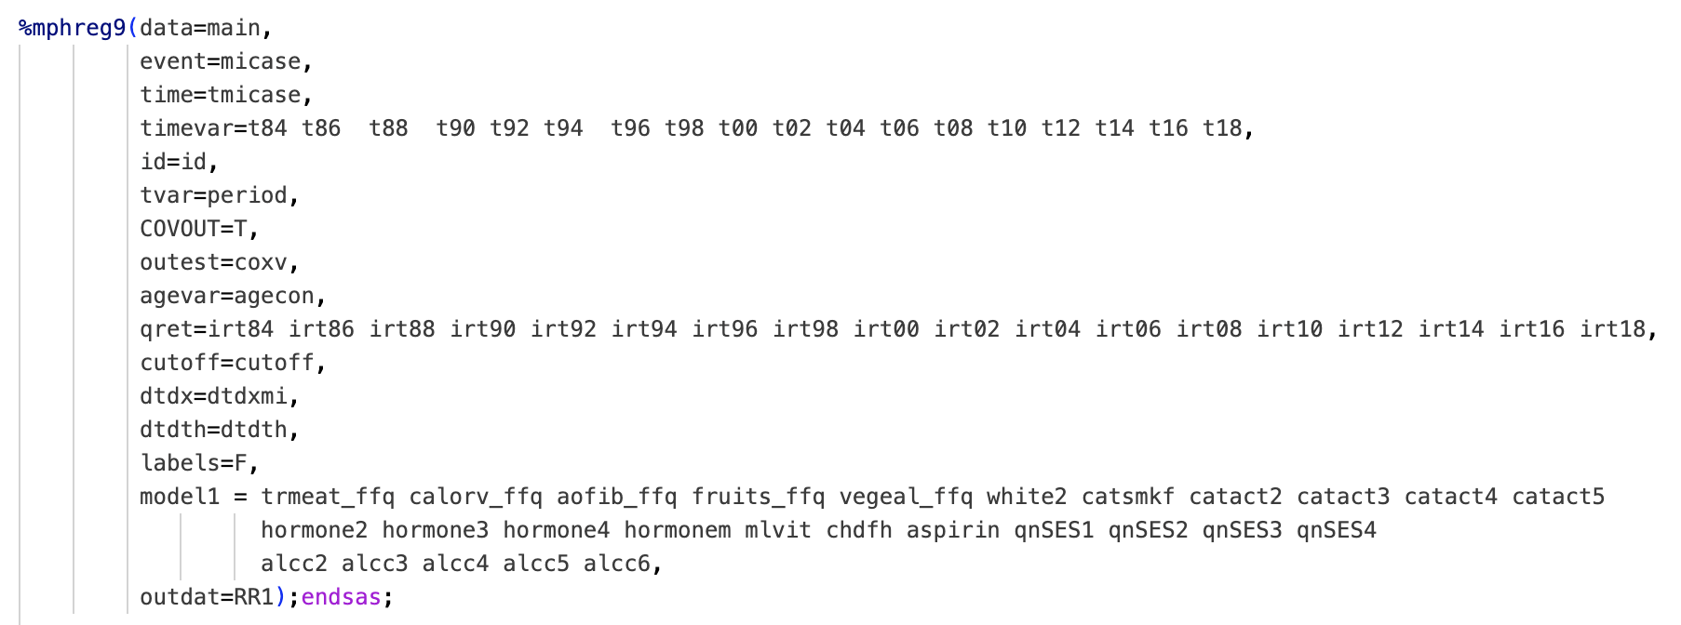
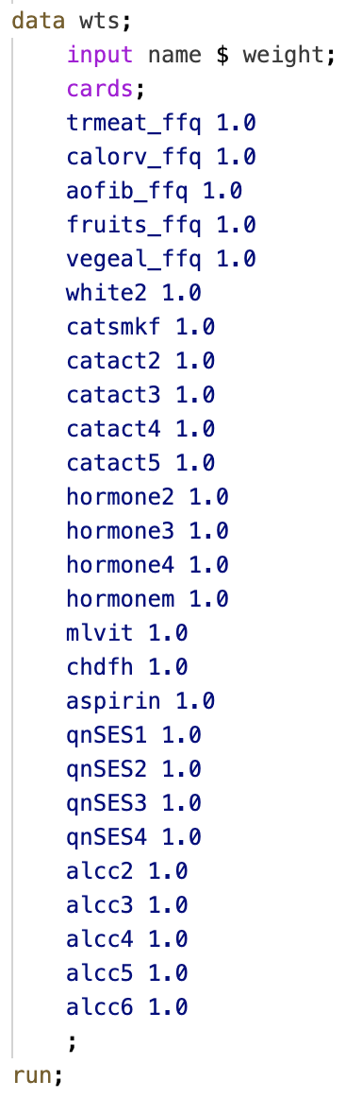
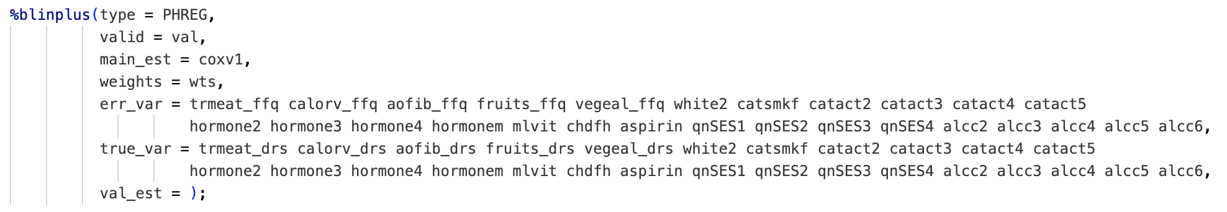
Correction for Baseline Red Meat and CHD – %BLINPLUS Call

Slide 9
Correction for Baseline Red Meat and CHD – %BLINPLUS Output
Uncorrected
Corrected
Main study regression coeffiecients: Uncorrected
________ _______________________________________________________________
WT B SE OR 95% CI p
________ _______________________________________________________________
trmeat_f 1.00 0.05459 0.02312 1.05611 1.00931 - 1.10507 0.01823
calorv_f 1.00 0.00006 0.00004 1.00006 0.99997 - 1.00015 0.17940
aofib_ff 1.00 -0.00701 0.00448 0.99301 0.98433 - 1.00176 0.11720
fruits_f 1.00 0.01475 0.01673 1.01486 0.98212 - 1.04869 0.37797
vegeal_f 1.00 0.01506 0.01778 1.01518 0.98041 - 1.05118 0.39686
white2 1.00 0.16960 0.09672 1.18483 0.98023 - 1.43213 0.07951
catsmkf 1.00 0.84709 0.03676 2.33286 2.17071 - 2.50712 0.00000
catact2 1.00 -0.25056 0.03687 0.77836 0.72409 - 0.83670 0.00000
catact3 1.00 -0.35745 0.04241 0.69946 0.64366 - 0.76009 0.00000
catact4 1.00 -0.36285 0.05122 0.69569 0.62924 - 0.76916 0.00000
catact5 1.00 -0.61674 0.04751 0.53970 0.49171 - 0.59238 0.00000
hormone2 1.00 0.32160 0.09354 1.37933 1.14828 - 1.65689 0.00059
hormone3 1.00 0.20076 0.09543 1.22234 1.01382 - 1.47373 0.03539
hormone4 1.00 0.25203 0.09605 1.28664 1.06586 - 1.55314 0.00869
hormonem 1.00 0.49876 0.09927 1.64668 1.35553 - 2.00035 0.00000
mlvit 1.00 -0.10755 0.03009 0.89803 0.84661 - 0.95259 0.00035
chdfh 1.00 0.46720 0.03063 1.59552 1.50255 - 1.69423 0.00000
aspirin 1.00 0.05260 0.02919 1.05401 0.99539 - 1.11608 0.07156
qnSES1 1.00 -0.03141 0.04327 0.96908 0.89029 - 1.05484 0.46789
qnSES2 1.00 -0.07255 0.04396 0.93002 0.85325 - 1.01370 0.09884
qnSES3 1.00 -0.10169 0.04424 0.90331 0.82828 - 0.98514 0.02153
qnSES4 1.00 -0.21219 0.04616 0.80881 0.73884 - 0.88540 0.00000
alcc2 1.00 -0.05706 0.03441 0.94454 0.88294 - 1.01043 0.09724
alcc3 1.00 -0.15967 0.05077 0.85243 0.77169 - 0.94161 0.00166
alcc4 1.00 -0.22633 0.05011 0.79746 0.72286 - 0.87975 0.00001
alcc5 1.00 -0.22632 0.06195 0.79747 0.70628 - 0.90042 0.00026
alcc6 1.00 -0.16177 0.06718 0.85064 0.74569 - 0.97036 0.01605
Main study regression coefficients: Corrected
________ _______________________________________________________________
WT B SE OR 95% CI p
________ _______________________________________________________________
trmeat_f 1.00 0.08461 0.04490 1.08830 0.99661 - 1.18842 0.05951
calorv_f 1.00 0.00021 0.00018 1.00021 0.99984 - 1.00057 0.26635
aofib_ff 1.00 -0.00988 0.00885 0.99017 0.97315 - 1.00749 0.26401
fruits_f 1.00 0.03340 0.03426 1.03397 0.96682 - 1.10578 0.32956
vegeal_f 1.00 0.03357 0.05985 1.03414 0.91967 - 1.16286 0.57488
white2 1.00 0.18166 0.10011 1.19920 0.98554 - 1.45919 0.06960
catsmkf 1.00 0.83686 0.04729 2.30911 2.10469 - 2.53339 0.00000
catact2 1.00 -0.27959 0.05010 0.75610 0.68538 - 0.83411 0.00000
catact3 1.00 -0.39944 0.05673 0.67070 0.60011 - 0.74958 0.00000
catact4 1.00 -0.40176 0.06479 0.66914 0.58934 - 0.75974 0.00000
catact5 1.00 -0.64079 0.06183 0.52688 0.46675 - 0.59476 0.00000
hormone2 1.00 0.32490 0.09443 1.38389 1.15005 - 1.66528 0.00058
hormone3 1.00 0.20050 0.09641 1.22201 1.01161 - 1.47617 0.03755
hormone4 1.00 0.26910 0.09763 1.30879 1.08085 - 1.58479 0.00584
hormonem 1.00 0.49959 0.10307 1.64804 1.34658 - 2.01699 0.00000
mlvit 1.00 -0.08887 0.03179 0.91497 0.85970 - 0.97379 0.00518
chdfh 1.00 0.47968 0.03290 1.61556 1.51467 - 1.72317 0.00000
aspirin 1.00 0.04315 0.03033 1.04410 0.98384 - 1.10804 0.15480
qnSES1 1.00 -0.02259 0.04521 0.97766 0.89476 - 1.06824 0.61726
qnSES2 1.00 -0.05987 0.04607 0.94189 0.86057 - 1.03089 0.19376
qnSES3 1.00 -0.09834 0.04642 0.90634 0.82753 - 0.99266 0.03412
qnSES4 1.00 -0.21049 0.04754 0.81019 0.73811 - 0.88931 0.00001
alcc2 1.00 -0.05378 0.03647 0.94764 0.88227 - 1.01786 0.14030
alcc3 1.00 -0.14742 0.05229 0.86293 0.77888 - 0.95606 0.00481
alcc4 1.00 -0.23425 0.05457 0.79116 0.71091 - 0.88047 0.00002
alcc5 1.00 -0.23839 0.06743 0.78789 0.69036 - 0.89921 0.00041
alcc6 1.00 -0.18096 0.07548 0.83447 0.71972 - 0.96753 0.01651
Hazard ratios (HR) and 95% confidence intervals (CI) for total red meat, fruits, and vegetables intake are for per 1 serving/day increment.
Total energy intake is expressed per 1 kcal/day increment, and dietary fiber is expressed per 1 gram/day increment.
Categorical covariates, including physical activity (catact), post-menopausal hormone use (hormone), and neighborhood socio-economic status (nSES), and alcohol intake (alcc) are represented as dummy-coded variables.

Slide 10
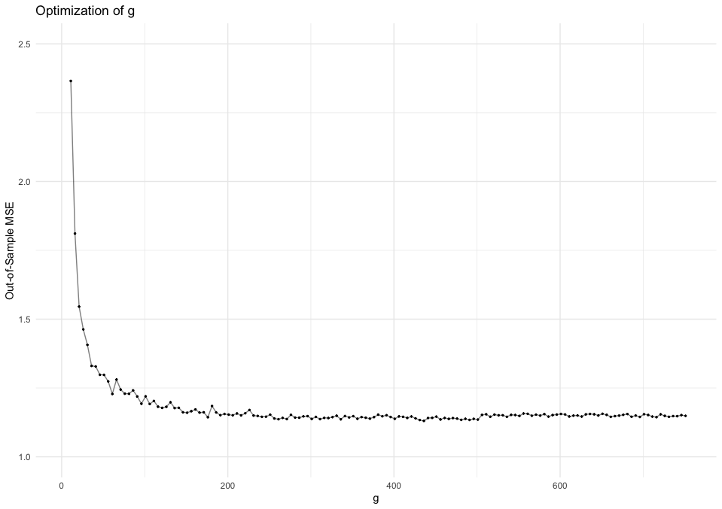

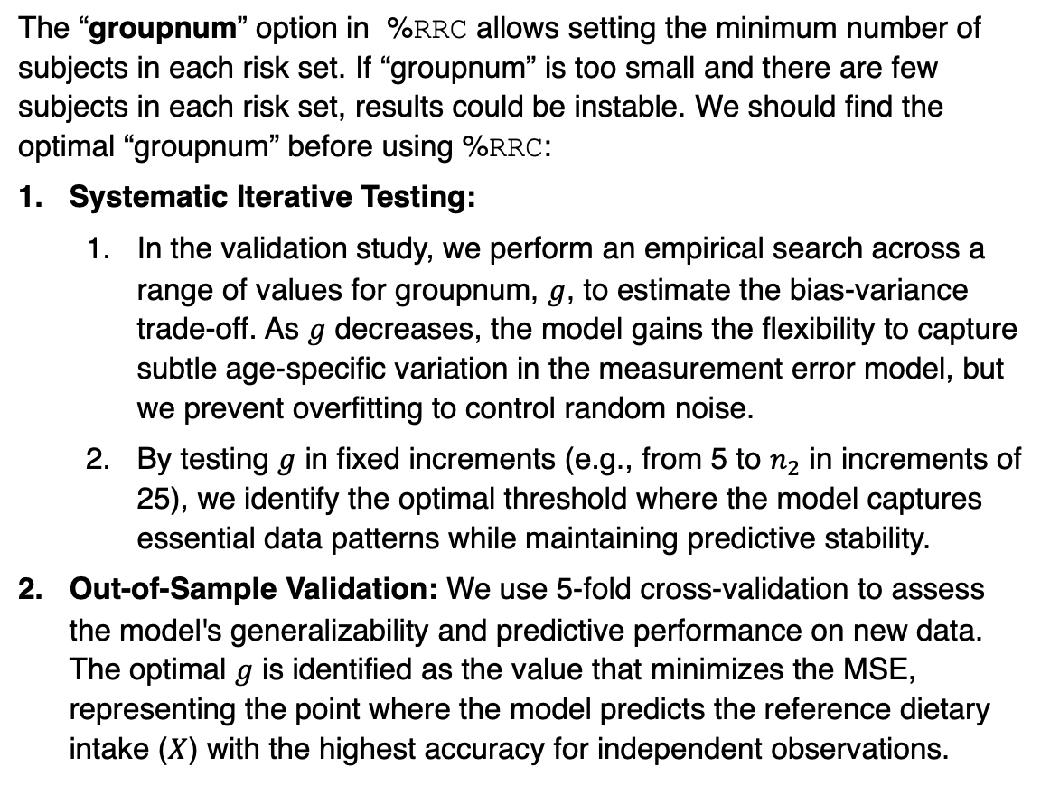
How to divide up the validation data into age groups with relatively constant measurement error for risk set regression calibration?
The “groupnum” option in %RRC allows setting the minimum number of subjects in each risk set. If “groupnum” is too small and there are few subjects in each risk set, results could be instable. We should find the optimal “groupnum” before using %RRC:
Systematic Iterative Testing:
In the validation study, we perform an empirical search across a range of values for groupnum, $g$, to estimate the bias-variance trade-off. As $g$ decreases, the model gains the flexibility to capture subtle age-specific variation in the measurement error model, but we prevent overfitting to control random noise.
By testing $g$ in fixed increments (e.g., from 5 to $n_{2}$ in increments of 25), we identify the optimal threshold where the model captures essential data patterns while maintaining predictive stability.
Out-of-Sample Validation: We use 5-fold cross-validation to assess the model's generalizability and predictive performance on new data. The optimal $g$ is identified as the value that minimizes the MSE, representing the point where the model predicts the reference dietary intake ($X$) with the highest accuracy for independent observations.
*$g$ at the minimum out-of-sample MSE is 455

Slide 11
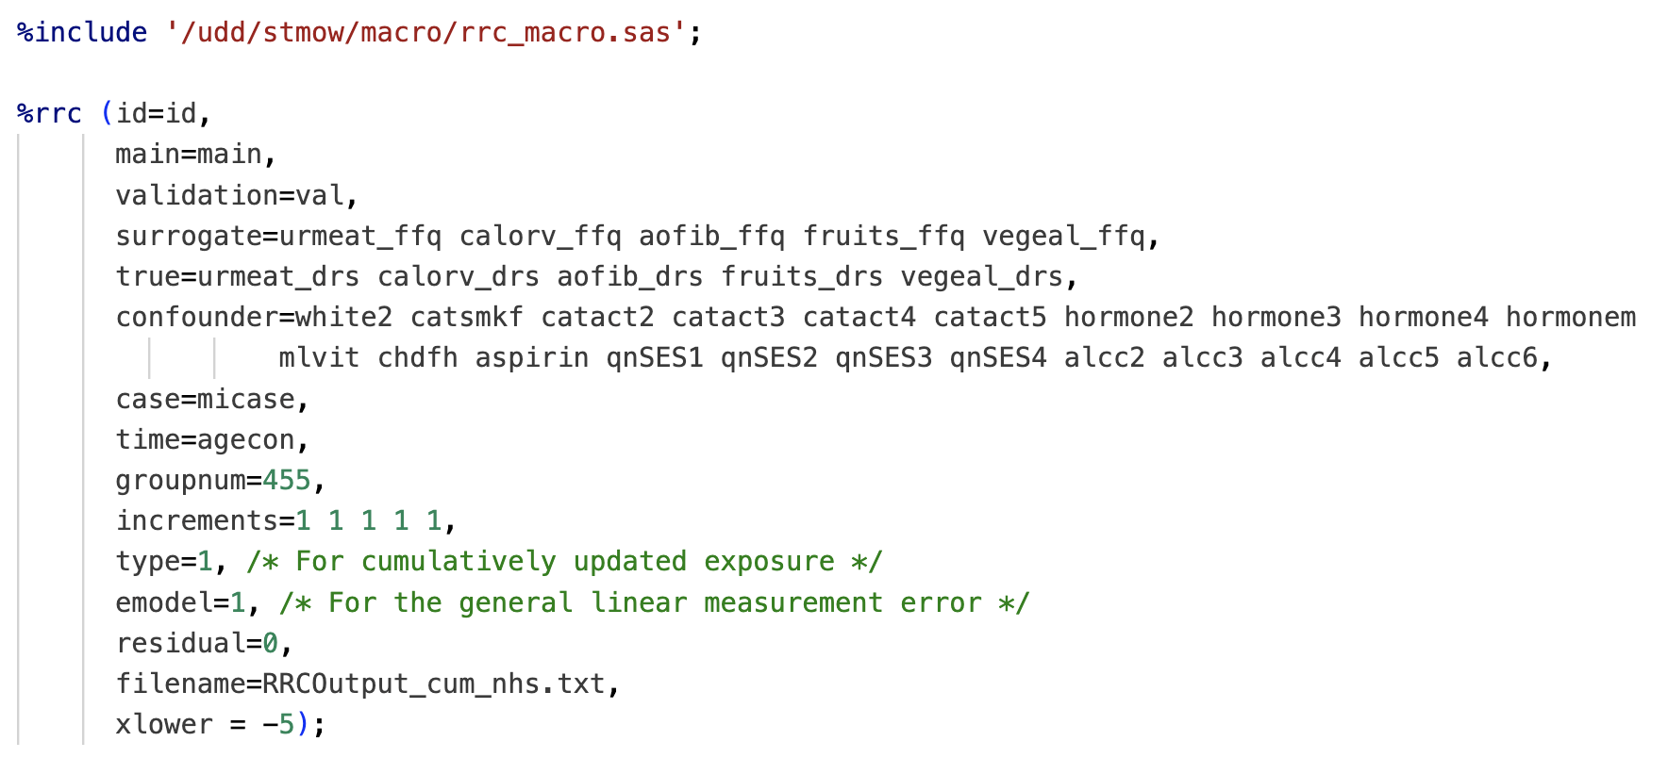
Correction for Cumulative Average Red Meat and CHD – %RRC Call

Slide 12
Correction for Cumulative Average Red Meat and CHD – %RRC Output
%%%%%%%%%%%%%%%%%%%%%%%%%%%%%%%%%%%%%%%%%%%%%
This analysis is for cumulatively average updated exposure
with general linear measurement error model.
The increment for each exposure is: 1.0000000000000000 1.0000000000000000 1.0000000000000000 1.0000000000000000 1.0000000000000000
# of subjects in the main study: 84354
# of person-year observations in the main study: 1306905
# of cases in the main study: 5067
# of unique failure time: 58
# of subjects in the validation study: 741
# of person-year observations in the validation study: 741
# of risk sets in the validation study: 1
----------------------------------------------
Information about the measurement error model
fitting in the validation study:
----------------------------------------------
Risk_set Age_low Age_up Person_year Intercept slope R^2
1 39.0 96.0 741 0.761 0.587 -0.000 -0.013 -0.001 0.049 0.331
******* 0.875 0.238 -3.640 -18.317 -11.798 0.069
11.066 -0.773 -0.005 0.701 -0.319 -0.579 0.263
0.205 -0.060 -0.000 0.027 0.438 -0.034 0.371
0.655 -0.026 -0.000 0.025 0.024 0.262 0.217

Slide 13
Uncorrected
Corrected
----------------------------------------------
Uncorrected result:
Variable Para_es S.E. p_val H.R. 95% C.I.
trmeat_ffq 0.151 0.031 0.000 1.163 [ 1.09, 1.24]
calorv_ffq -0.000 0.000 0.929 1.000 [ 1.00, 1.00]
aofib_ffq -0.018 0.006 0.002 0.982 [ 0.97, 0.99]
fruits_ffq 0.110 0.021 0.000 1.116 [ 1.07, 1.16]
vegeal_ffq 0.041 0.019 0.028 1.042 [ 1.00, 1.08]
white2 0.210 0.097 0.030 1.234 [ 1.02, 1.49]
catsmkf 0.890 0.037 0.000 2.436 [ 2.27, 2.62]
catact2 -0.249 0.037 0.000 0.780 [ 0.73, 0.84]
catact3 -0.359 0.043 0.000 0.699 [ 0.64, 0.76]
catact4 -0.378 0.051 0.000 0.685 [ 0.62, 0.76]
catact5 -0.669 0.048 0.000 0.512 [ 0.47, 0.56]
hormone2 0.355 0.093 0.000 1.427 [ 1.19, 1.71]
hormone3 0.267 0.095 0.005 1.307 [ 1.08, 1.57]
hormone4 0.149 0.095 0.119 1.161 [ 0.96, 1.40]
hormonem 0.413 0.099 0.000 1.512 [ 1.25, 1.84]
mlvit -0.105 0.030 0.000 0.900 [ 0.85, 0.95]
chdfh 0.460 0.031 0.000 1.584 [ 1.49, 1.68]
aspirin 0.078 0.029 0.007 1.081 [ 1.02, 1.14]
qnSES1 -0.035 0.043 0.421 0.966 [ 0.89, 1.05]
qnSES2 -0.103 0.044 0.019 0.903 [ 0.83, 0.98]
qnSES3 -0.114 0.044 0.010 0.893 [ 0.82, 0.97]
qnSES4 -0.262 0.046 0.000 0.770 [ 0.70, 0.84]
alcc2 -0.085 0.036 0.019 0.919 [ 0.86, 0.99]
alcc3 -0.176 0.050 0.000 0.839 [ 0.76, 0.92]
alcc4 -0.269 0.060 0.000 0.764 [ 0.68, 0.86]
alcc5 -0.313 0.061 0.000 0.731 [ 0.65, 0.82]
alcc6 -0.246 0.084 0.003 0.782 [ 0.66, 0.92]
----------------------------------------------
RRC result (Zhou):
Variable Para_es S.E. p_val H.R. 95% C.I.
trmeat_ffq 0.407 0.104 0.000 1.503 [ 1.22, 1.84]
calorv_ffq -0.001 0.001 0.278 0.999 [ 1.00, 1.00]
aofib_ffq -0.005 0.025 0.851 0.995 [ 0.95, 1.05]
fruits_ffq 0.177 0.073 0.016 1.194 [ 1.03, 1.38]
vegeal_ffq -0.106 0.157 0.500 0.900 [ 0.66, 1.22]
white2 0.337 0.120 0.005 1.401 [ 1.11, 1.77]
catsmkf 0.858 0.067 0.000 2.359 [ 2.07, 2.69]
catact2 -0.259 0.062 0.000 0.772 [ 0.68, 0.87]
catact3 -0.355 0.073 0.000 0.701 [ 0.61, 0.81]
catact4 -0.370 0.083 0.000 0.691 [ 0.59, 0.81]
catact5 -0.647 0.085 0.000 0.524 [ 0.44, 0.62]
hormone2 0.337 0.100 0.001 1.401 [ 1.15, 1.70]
hormone3 0.251 0.099 0.011 1.286 [ 1.06, 1.56]
hormone4 0.123 0.103 0.232 1.131 [ 0.92, 1.38]
hormonem 0.394 0.114 0.001 1.483 [ 1.19, 1.85]
mlvit -0.101 0.032 0.002 0.904 [ 0.85, 0.96]
chdfh 0.479 0.045 0.000 1.614 [ 1.48, 1.76]
aspirin 0.065 0.030 0.032 1.067 [ 1.01, 1.13]
qnSES1 -0.027 0.048 0.580 0.974 [ 0.89, 1.07]
qnSES2 -0.102 0.055 0.063 0.903 [ 0.81, 1.01]
qnSES3 -0.091 0.051 0.075 0.913 [ 0.83, 1.01]
qnSES4 -0.236 0.054 0.000 0.790 [ 0.71, 0.88]
alcc2 -0.060 0.047 0.201 0.941 [ 0.86, 1.03]
alcc3 -0.142 0.060 0.019 0.868 [ 0.77, 0.98]
alcc4 -0.224 0.084 0.007 0.799 [ 0.68, 0.94]
alcc5 -0.246 0.098 0.012 0.782 [ 0.65, 0.95]
alcc6 -0.166 0.130 0.204 0.847 [ 0.66, 1.09]
Hazard ratios (HR) and 95% confidence intervals (CI) for total red meat, fruits, and vegetables intake are for per 1 serving/day increment.
Total energy intake is expressed per 1 kcal/day increment, and dietary fiber is expressed per 1 gram/day increment.

